Slide 1
RESULTS monitoring & data quality assurance
LBI meeting, October 29th , 2013, Nelson

Slide 2
RESULTS project details
In September 2011, Resource Practices Branch awarded to CTQ.
CTQ identified RESULTS openings with one or more of 11 high priority data issues where FPPR Section 86 annual reporting requirements or relevant submissions specifications were not met.

Slide 3
FPPR Section 86 – Annual Reporting
1 Our review of satellite imagery indicates that some harvesting has been completed. If this harvesting was completed prior to this reporting period, silviculture records must be submitted to RESULTS.
2 The RESULTS harvesting, forest cover and possibly SUs have not been reported.
3 The RESULTS forest cover has not been reported.
4 The RESULTS harvesting activity has not been reported.
5 The RESULTS stocking standards are missing or incomplete.
6 The RESULTS free growing forest cover submission has not been reported (free growing declared).
86 (3) (a)
87 (1) – (4)
86 (3) (d) (iii)
Sec 87 is Site Specific Standards

Slide 4
FPPR Section 86 – Annual Reporting
7 The RESULTS free growing forest cover submission has not been reported (free growing overdue).
8 The RESULTS regeneration forest cover submission has not been reported (regen declared).
9 The RESULTS regeneration forest cover submission has not been reported (regen overdue).
10 Issue dropped from the high priority list
11 The RESULTS forest cover is missing spatial
12 The RESULTS opening spatial is missing
86 (3) (d) (iv)
86 (3) (d) (i)
86(3) (d) (ii)
86 (6) F0rm and Manner
of Reporting

Slide 5
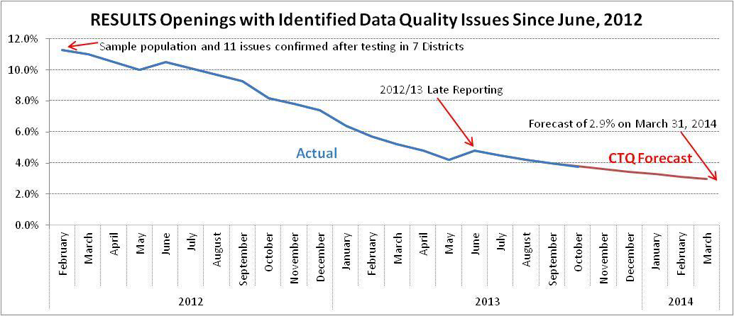
Project performance from June, 2012 to October, 2013 and forecast to March, 2014

Slide 6
Success of project
Since February 2012, the number of high priority RESULTS data quality issues has been reduced from 19,553 to 7,052 (10.5% to 3.8%).
CTQ forecasts that another 1,550 issues will be corrected by March 31, 2014.
Due to continued support from Districts and Licensees.

Slide 7
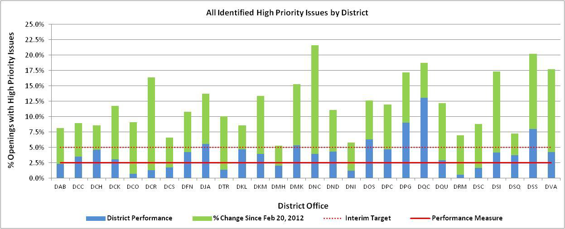
District performance as of October 1, 2013

